Slide 1
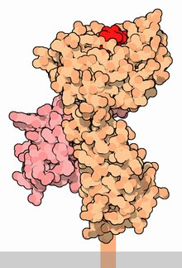
Major Histocompatibility Complex
Dr. (Ms.) Sonali Correa

Slide 2
Definition
Is a set of surface proteins located in the cell membrane of nucleated cells.
It plans an important role in identification of self and non self antigen body, intracellular recognition and responsible for antigen presentation
This locus got its name because it was discovered via the study of transplanted tissue compatibility.
Histo referred to tissue and compatibility referred to as harmonious living
Is a large locus on vertebrate DNA containing a set of closely linked polymorphic genes that code for cell surface proteins essential for the adaptive immune system.
These cell surface proteins are called MHC molecules.
The function of MHC molecules is to bind peptide fragments derived from pathogens and display them on the cell surface for recognition by the appropriate T cells.
In humans the MHC is found on Chromosome 6 referred to as the HLA complex

Slide 3
Historical background
The first descriptions of the MHC were made by British immunologist Peter Gorer in 1936. MHC genes were first identified in inbred mice strains.
He identified the four group of MHC molecules in the blood sample of mice when he identified the blood group antigen and was designated as class I to IV

Slide 4
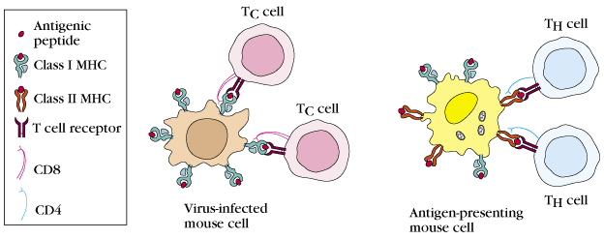

Slide 5
Structure and functions of MHC

Slide 6
MHC class-I
Class-I MHC gene encodes glycoprotein molecule which expressed on the surface of all nucleated cells and platelets ie by all body cells except red blood cells aka HLA-A, -B, and -C genes.
It present antigens Tc cells
Present intracellular antigens to CD8+ T-cells
When a cell becomes cancerous or is invaded by a virus, unfamiliar proteins are synthesized in the cell. These proteins are endogenous antigens—that is, antigens produced inside the cell. Portions of these antigens are combined with MHC‐I glycoproteins and, when displayed on the plasma membrane, indicate a nonself cell.
MHC-I molecule contains a two polypeptide chains
45KDa α-chain associated non-covalently with a
12KDa β2 microglobulin molecule.
Association of α-chain and β2 microglobulin is required for expression of class-I MHC molecule on cell membrane.
Notes:
MHC‐I glycoproteins are produced by all body cells (except red blood cells).
When a cell becomes cancerous or is invaded by a virus, unfamiliar proteins are synthesized in the cell. These proteins are endogenous antigens—that is, antigens produced inside the cell. Portions of these antigens are combined with MHC‐I glycoproteins and, when displayed on the plasma membrane, indicate a nonself cell.

Slide 7
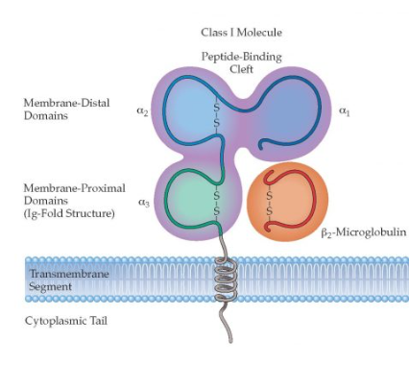
Class I MHC Molecule
α-chain
3 external domains- each approximately 90 amino acids long
A transmembrane domain – 25 hydrophobic amino acids & a short chain of charged hydrophilic amino acids
A cytoplasmic anchor segment- 30 amino acids
β2 microglobulin
Similar in size & organization to α3 domain
No transmembrane region
Bound non covalently to the α domain
There are no known differences in the structure of the human MHC Class I antigen a chains encoded by the HLA-A locus compared to those encoded by the HLA-B or the HLA-C loci, or in the structure of the murine MHC Class I antigen a chains encoded by the H-2K locus compared to those encoded by the H-2D or H-2L loci.

Slide 8
Structure of MHC Class I
MHC Class I molecules in both human and mouse consist of two polypeptide chains that dramatically differ in size.
The larger (α) chain has a molecular weight of 44 kDa in humans and 47 kDa in the mouse, and is encoded by an MHC Class I gene.
The smaller chain, called β-2 microglobulin, has a molecular weight of 12 kDa in both species, and is encoded by a nonpolymorphic gene that is mapped outside of the MHC complex.
There are no known differences in the structure of the human MHC Class I antigen a chains encoded by the HLA-A locus compared to those encoded by the HLA-B or the HLA-C loci, or in the structure of the murine MHC Class I antigen a chains encoded by the H-2K locus compared to those encoded by the H-2D or H-2L loci.

Slide 9
Class II MHC Molecule
Antigen presenting cells
Present extracellular antigens to the CD4+ T cells
Initiate immune responses
The antigens presented by class II peptides are derived from extracellular proteins (not cytosolic as in MHC class I)
Consists of two different polypeptide chains
α-chain- 33 kDa
β-chain- 28 kDa

Slide 10
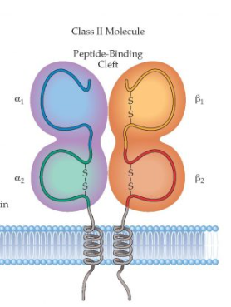
Class II MHC Molecule
α-chain
Contains 2 extracellular domains – α1 & α2
A transmembrane segment
A cytoplasmic anchor segment
β-chain
Similar to the α chain
Contains 2 extracellular domains -β1 and β2
The peptide biding cleft is a open ended groove formed between α-chain and β-chain at proximal end. The cleft can bind antigenic peptide of 13-18 aminoacids long.

Slide 11
Class III
Class III MHC genes encode for various secreted proteins that have immune functions, including the component of the complement system and molecules that are involved in inflammation such as cytokines.

Slide 12
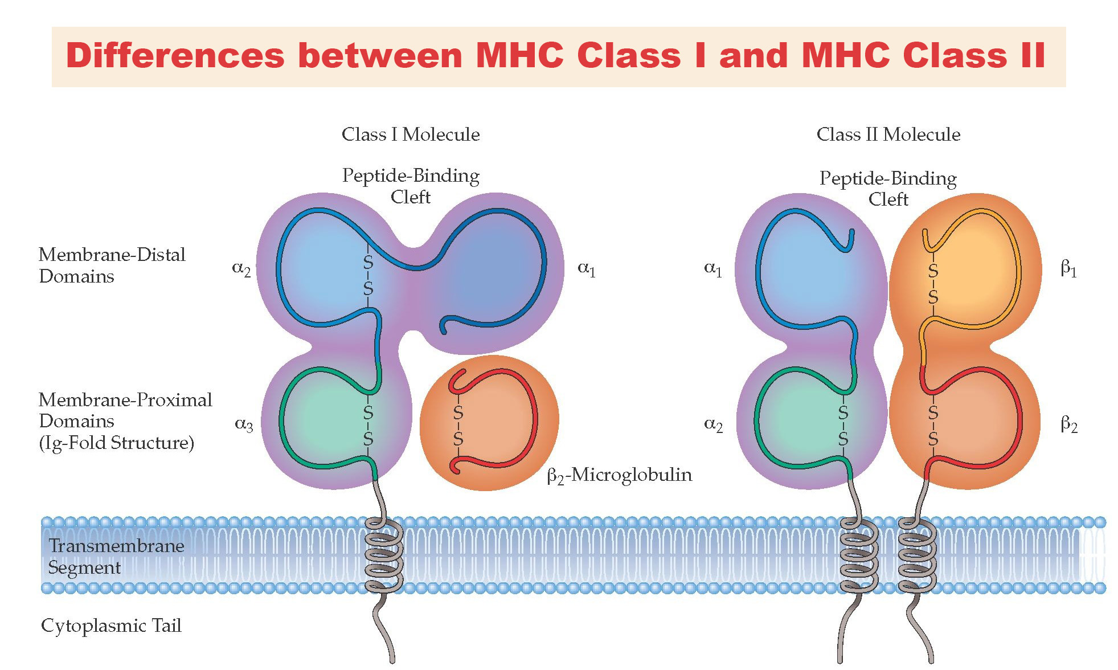

Slide 13
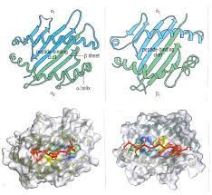
Peptide-MHC interactions
peptide binding cleft commonly accommodates peptides 8 to 11 amino acids long and the classical function of HLA-B27 is to present peptides to a variety of ligands, in particular T-cell receptors on the surface of CD8+ cytotoxic T lymphocytes (CTLs).
MHC Class I
• α1 and α2 domains form peptide-binding domains • Antiparallel eight stranded β-pleated sheet form the floor • Two long α helices, oriented adjacent and roughly parallel to each other form sides of the deep cleft • Closed ends, accommodate about 8-11 aa in a flexible, extended conformation • Solvent Accessibility • About 80% Buried.
MHC Class II •
Two long α helices as sides and the β sheet as bottom • The ends of class II peptide-binding cleft are more open, bind longer and irregular peptides (12-16 aa be optimal)
Longer peptides. Ends can hang out. • Central core of about 13 amino acids. • Allele-specific binding motifs. • No bulge.

Slide 14
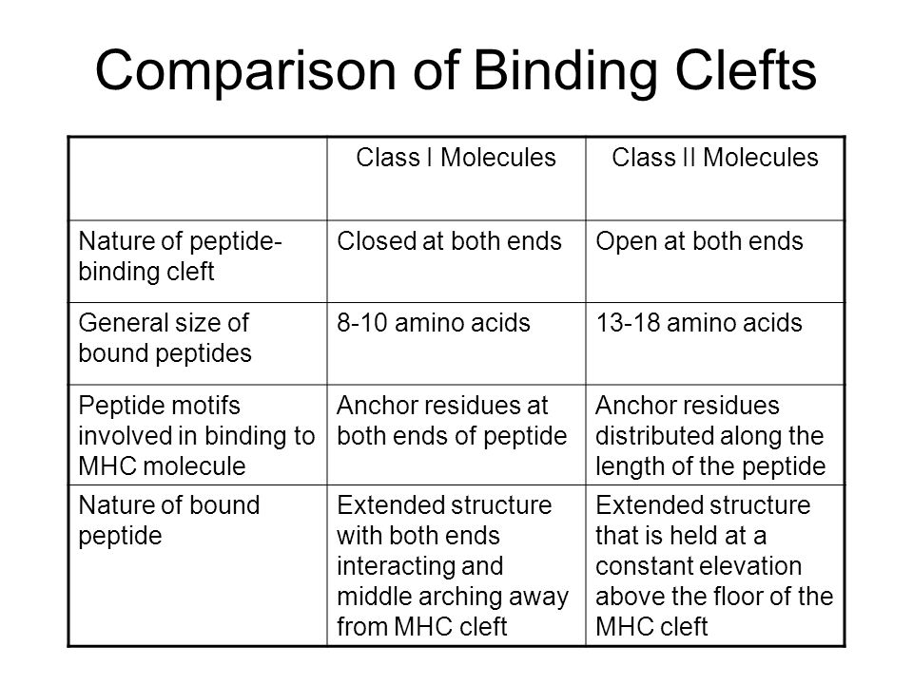

Slide 15
There are about a dozen of types of classical HLA
molecules on the cell surface for one individual
• There are much, much, much more kinds of antigen peptides would be presented in one individual
Some amino acid residues of peptides anchor the peptide into the pockets within the groove of the MHC molecule, called anchor residue.
a given MHC molecule binds a group peptides with same anchor residues
The different MHC molecules bind different groups of peptide

Slide 16
SYFPEITHI-peptide database
SYFPEITHI, a database of interactions between proteins of the major histocompatibility complex (MHC) and antigenic peptides, contains information on MHC-associated peptide sequences, anchor positions, MHC molecule specificities and references to the published literature.
SYFPEITHI, a database of interactions between proteins of the major histocompatibility complex (MHC) and antigenic peptides, contains information on MHC-associated peptide sequences, anchor positions, MHC molecule specificities and references to the published literature. It is named after one of the first defined MHC-bound epitopes, a peptide that bound to the MHC molecule H2-K^{d}. The database 'search' functions include epitope prediction and the retrieval of sequences on the basis of mass spectrometry data. The site also permits searching for epitopes associated with MHC molecules of known peptide-binding motif and allows for the definition of such motifs from sequence or mass spectrometry data.

Slide 17
Antigen presentation & processing
The recognition of protein antigens by T-lymphocytes required that the antigens be processed by Antigen-presenting Cells, then displayed within the cleft of the MHC molecules on the membrane of the cell.
This involves the degradation of the protein antigens into peptides, a process known as antigen processing.
When the antigen has been processed and degraded into peptides, it then associates with MHC molecules within the cell cytoplasm forming a peptide-MHC complex. This complex is then transported to the membrane, where it is displayed by a process of antigen presentation.
The MHC Class I and class II MHC molecules associated with peptides that have been processed in different intracellular compartments.
The Class I MHC molecules bind peptides derived from endogenous antigens that have been processed within the cytoplasm of the cell such as tumor proteins, bacterial proteins, or viral proteins, or cellular proteins, and processed within the cytosolic pathway.
Class II MHC molecules bind peptides derived from exogenous antigens that are internalized by phagocytosis or endocytosis and processed within the endocytic pathway.

Slide 18
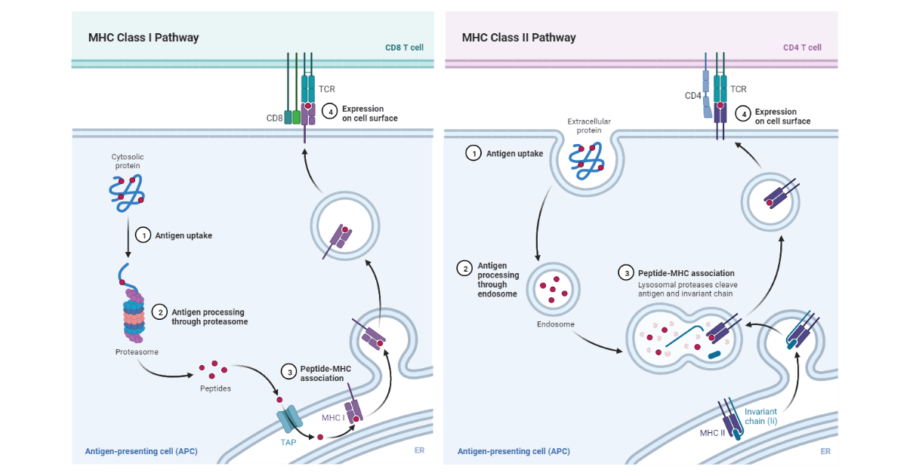

Slide 19
Cytosolic pathway: Endogenous antigen
This is the pathway that processes and presents the endogenous antigen using the Class I MHC molecules.
The antigen proteins are degraded intracellularly to short peptides by a cytosolic proteolytic system that is present in all cells. These proteins targeted for proteolysis have a small protein known as ubiquitin attached to them.
The ubiquitin-protein conjugate then gets degraded by a multifunctional protease complex known as a proteasome.
Each proteasome is a large (26S), cylindrical particle that consists of four rings of protein subunits and a central channel of 10–50 Å diameter.
The proteasome can cleave peptide bonds between 2-3 different amino acid combinations in an ATP-dependent process.
Degradation of the ubiquitin-protein complex takes place in the central hollow of the proteasome.
The peptides are then transported from the cytosol to the rough endoplasmic reticulum. This is enabled by the transporter protein, designated TAP (transporter associated with antigen processing) is a membrane-spanning heterodimer consisting of two proteins: TAP1 and TAP2.
The TAP1 and TAP2 proteins each have a domain projecting into the lumen of the Rough endoplasmic reticulum (RER), and an ATP-binding domain that extends into the cytosol.
Both TAP1 and TAP2 belong to the family of ATP-binding cassette proteins found in the membranes of many cells, including bacteria.
They mediate ATP-dependent transport of amino acids, sugars, ions, and peptides.

Slide 20
the peptides that are generated in the cytosol by the proteasome, are translocated into the Rough Endoplasmic Reticulum (RER) by TAP proteins by a process that utilizes hydrolyzed ATP. TAP proteins have a high affinity for peptides sizes of 8-10 amino acids, the optimum length for class I MHC binding.
Additionally, TAP proteins favor peptides with hydrophobic or basic carboxyl-terminal amino acids, which is the preferred anchor residue for class I MHC molecule, and therefore, TAP is optimized to transport peptides that will interact with class I MHC molecules.
Next, the peptides that are assembled with class I MHC are aided by chaperone molecules that facilitate the folding of polypeptides.
The alpha and beta-2-microglobulin components of the class I MHC molecules are synthesized on the polysomes along the rough endoplasmic reticulum. These components are assembled into a stable class I MHC molecules complex that can exit the RER requiring the presence of a peptide in the binding groove of the class molecule.

Slide 21
The first chaperone involved is known as calnexin, which is a resident membrane protein of the endoplasmic reticulum. Calnexin associates with the class I α chain and promotes its folding. When the Beta-2-microglobulin binds to the α chain, the calnexin is released, and the class I molecule associates with the chaperone calreticulin and with tapasin.
Tapasin is a TAP-associated protein that brings the TAP transporter into proximity with the class I molecule and allows it to acquire an antigenic peptide. The physical association of the α chain-beta-2-microglobulin heterodimer with the TAP protein promotes peptide capture by the class I molecule before the peptides are exposed to the RER.
The peptides not bound by class I molecules are rapidly degraded.
After binding, the class I molecule displays increased stability and can dissociate from calreticulin and tapasin, exit from the RER, and proceed to the cell surface via the Golgi.
An additional chaperone protein, ERp57, associates with calnexin and calreticulin complexes.
The precise role of this resident endoplasmic reticulum protein in the class I peptide assembly and loading process has not yet been defined, but it is thought to contribute to the formation of disulfide bonds during the maturation of class I chains.

Slide 22
Endocytic Pathway: Exogenous antigen
Antigen-presenting cells can internalize antigen by phagocytosis, endocytosis, or both. Macrophages internalize antigen by both phagocytosis and endocytosis. Most of the other APCs are poorly phagocytic and can only internalize the antigen by pinocytosis or endocytosis, whereas most other APCs are not phagocytic and therefore they internalize the exogenous antigen only by endocytosis of by pinocytosis. B-cells which are also APCs internalizes the antigen effectively by receptor-mediated endocytosis using antigen-specific membrane antibody receptors.
When the exogenous antigen is internalized, it is degraded into peptides in the compartments of the endocytic processing pathway.
The breaking down of antigens into peptides takes 1-3 hours to transverse the endocytic pathway and appear at the cell surface in the form of a peptide-class II MHC complex.
In this pathway, three acidic compartments: early endosome (pH 6.0-6.5), late endosome or endolysosomes (pH 5.0-6.0); and lysosomes (pH 4.5-5.0). The internalized antigen moves from the early to late endosomes and later to the lysosomes where they encounter the hydrolytic enzyme, with a decreasing pH in each compartment.
the lysosomes have a unique collection of 40 acid-dependent hydrolases including proteases, nucleases, glycosidases, lipases, phospholipases, and phosphatases. Within the compartments of the endocytic pathway, the antigen is degraded into oligopeptide made up of 13-18 residues, that bind to class II MHC molecule. The hydrolytic enzymes are active in low Ph, they inhibit antigen processing chemical agents that may increase the compartment pH and that of protease inhibitors.

Slide 23
Movement of the peptides from one compartment to the next has been associated with small transport vesicles.
After getting to the final compartments, they return to the cell periphery fusing with the plasma membrane, enabling the recycling of surface receptors.
The antigen-presenting cells express both MHCI and MHC II molecules, therefore to prevent binding of MHC II to the same set of antigenic peptides as those of class I MHC, some mechanisms must exist to prevent this.
When the MHC II has been synthesized within the RER, three pairs of class II chains associate with a preassembled trimer of a protein known as an invariant chain (Ii, CD74). The trimeric protein interacts with the peptide-binding cleft of the class II MHC molecules, preventing any endogenously derived peptides from binding to the cleft while the MHC class II remains within the RER.
The invariant chain is also involved in the folding of class II MHC and its chains, the exit from the RER, and routing it to the endocytic processing pathway from the trans-Golgi network into the endocytic vesicles.

Slide 24
Secondly, the peptides assemble with class II MHC molecule by displacing CLIP (Class-II associated invariant chain peptide). Most of class II MHC-invariant chain complexes are transported from the RER where they are formed through the Golgi complex and trans-Golgi network, and then through the endocytic pathway, moving from early endosomes to late endosomes then finally to the lysosomes.
This increases the proteolytic activity from each compartment to the next.
This causes the degradation of the invariant chain gradually, leaving a short fragment of the invariant chain known as the CLIP (Class II-associated invariant chain peptide) that remains bound to the class II molecule after the invariant chain has been cleaved with the endosomal compartment.
CLIP occupies the peptide-binding groove of the class II MHC molecule, preventing premature binding of the antigenic peptide. HLA-DM molecule catalyzes the exchange of CLIP with the antigenic peptides. It is found in mammalian cells, mice, and rabbits. HLA-DM is neoclassical and nonpolymorphic.
When the HLA-DM and class II CLIP complex react, it facilitates the exchange of CLIP for another peptide but in the presence of HLA-DO, it can bind to HLA-DM reducing the efficiency of the exchange reaction.
The HLA-DO which has a similar structure as that of HLA-DM helps to modulate the function of HLA-DM, however, the function is obscure.

Slide 25
Function of HLA molecules
• Antigen presentation
– process ： endogenous antigen and exogenous
antigen
– presentation recognize MHC: peptide complex
(double recognition)
– MHC restriction of T cell: Any individual’s T cells
respond to a specific MHC allele expressed by that
individual, that is to “self” MHC
• others
– Genetically regulator of immune response, so to
predispose individuals to particular susceptibility or
disorders
– Immune regulation

Slide 26
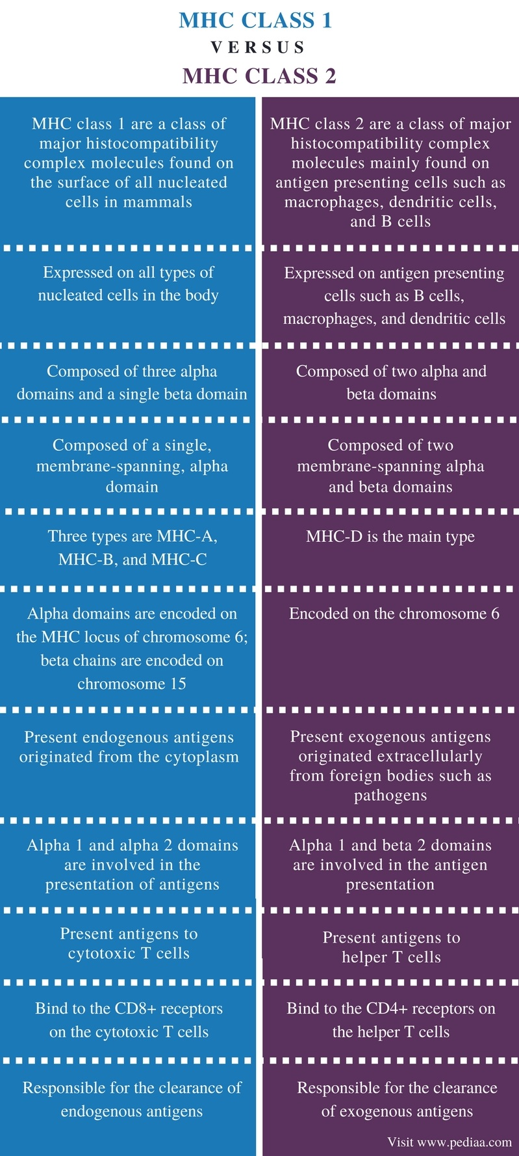

Slide 27
What are the genetic mechanisms?
Nota bene: whatever are the genetic mechanisms, they must account for the huge diversity of “haplotypes”
“Haplotype”: “the set of alleles of linked genes present on one parental chromosome…” cf. synteny
“Synteny”: the association of genes in a distinct region of a chromosome
Polygenecity
Polymorphism
Co-dominance
Linkage disequilibrium

Slide 28
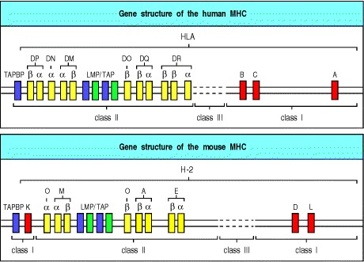
The genes encoding the α chains of MHC class I molecules and the α and β chains of MHC class II molecules are linked within the complex
The genes for β2-microglobulin and the invariant chain are on different chromosomes (chromosomes 15 and 5, respectively, in humans and chromosomes 2 and 18 in the mouse).
In humans these genes are called Human Leukocyte Antigen or HLA genes
Notes:
, as they were first discovered through antigenic differences between white blood cells from different individuals; in the mouse they are known as the H-2 genes.

Slide 29
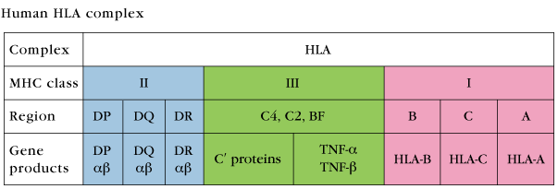
Classification
POLYGENECITY
POLYMORPHISM
CO-DOMINANCE
LINKAGE DISEQUILIBRIUM
Notes:
First, the MHC is polygenic: it contains several different MHC class I and MHC class II genes, so that every individual possesses a set of MHC molecules with different ranges of peptide-binding specificities.
Second, the MHC is highly polymorphic; that is, there are multiple variants of each gene within the population as a whole. The MHC genes are, in fact, the most polymorphic genes known.

Slide 30
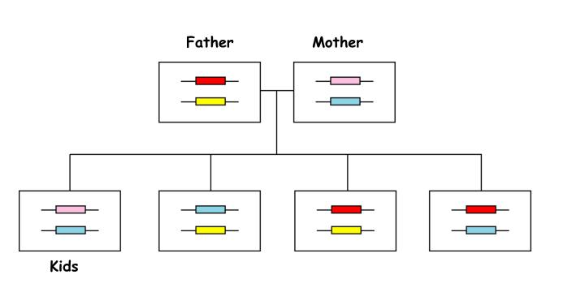
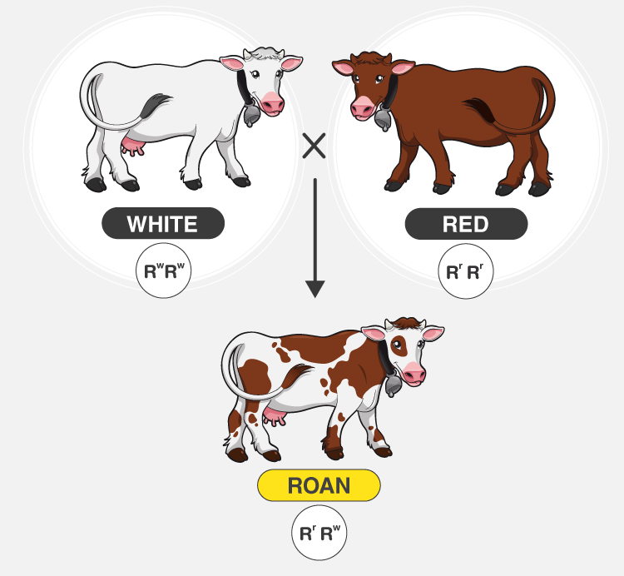
The most intensely-studied HLA genes are the nine so-called classical MHC genes:
HLA-A, HLA-B, HLA-C, HLA-DPA1, HLA-DPB1, HLA-DQA1, HLA-DQB1, HLA-DRA, and HLA-DRB1.
The A, B, C, E, F, and G genes belong to MHC class I,
whereas the six D genes belong to class II.
MHC genes are expressed in co-dominant fashion. This means that the alleles inherited from both progenitors are expressed in an equivalent way.
As there are 3 Class-I genes, named in humans HLA-A, HLA-B and HLA-C, and as each person inherits a set of genes from each progenitor, that means that any cell in an individual can express 6 different types of MHC-I molecules.
Co-dominant Expression

Slide 31
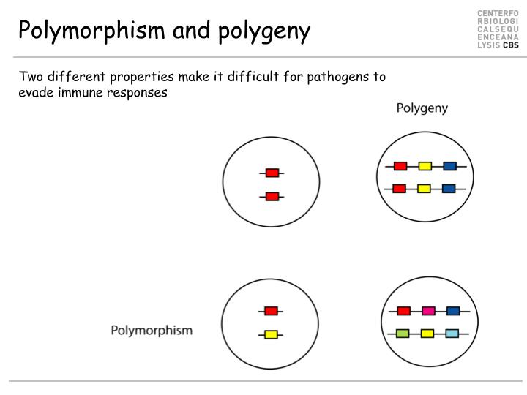
Polygeny
In the Class-II locus, each person inherits \
couple of genes HLA-DP (DPA1 and DPA2, which encode α and β chains),
a couple of genes HLA-DQ (DQA1 and DQA2, for α and β chains),
one gene HLA-DRα (DRA1)
one or two genes HLA-DRβ (DRB1 and DRB3, -4 o -5).
That means that one heterozygous individual can inherit 6 or 8 Class-II alleles, three or four from each progenitor.
The set of alleles that is present in each chromosome is called MHC haplotype.
In humans, each HLA allele is named with a number.
Each heterozygous individual will have two MHC haplotypes, one in each chromosome (one of paternal origin and the other of maternal origin).
The MHC genes are highly polymorphic; this means that there are many different alleles in the different individuals inside a population.
The polymorphism is so high that in a mixed population (non-endogamic) there are not two individuals with exactly the same set of MHC genes and molecules, with the exception of identical twins.
Polymorphic

Slide 32
MHC proteins (from the “haplotype”) constitute a life-long cell surface character for any vertebrate.
This circumstance is very different from Ig’s which are constantly being generated in response to new foreign proteins and carbohydrates in the environment.
The loci which specify MHC’s are polymorphic.
Many alleles may exist at a locus:
HLA A locus ~ 60 alleles
HLA B locus ~ 110 alleles
HLA C locus ~ 40 alleles
The high level of allelism creates diversity within a species (thus restricting allografting) but does not produce diversity within an individual.
Notes:
the transplantation of cells, tissues, or organs to a recipient from a genetically non-identical donor of the same species.

Slide 33
MHC gene region
The gene map for the extended major histocompatibility complex (xMHC) comprises 421 loci (excluding RNA genes) in a sequence length of 7.6 Mb — extending the previous gene map of the classical MHC, which was 3.6 Mb long and contained 224 loci.
All 421 xMHC loci have been assigned definitive and approved gene symbols.
About 50% of the xMHC gene loci are present in clusters or superclusters that are not restricted only to immune genes. The two largest clusters, comprising histone and tRNA genes are the largest of their type in the genome.
Transcription hotspot analysis indicates that it is just as likely that the classical MHC is hitch-hiking with gene clusters of the xMHC as the reverse.
About 22% of the expressed xMHC genes show a higher than average number of non-synonymous coding polymorphisms.
About 28% of the xMHC genes can be associated with immune system function.
About 10% of the xMHC genes are currently known to be disease-causing or disease-associated.
About 20% of the xMHC genes have putative paralogues elsewhere in the genome, indicating considerable potential for functional redundancy.
The gene map of the xMHC provides an invaluable resource for the study of the most important genetic region of the human genome in relation to infectious, inflammatory and autoimmune diseases.

Slide 34
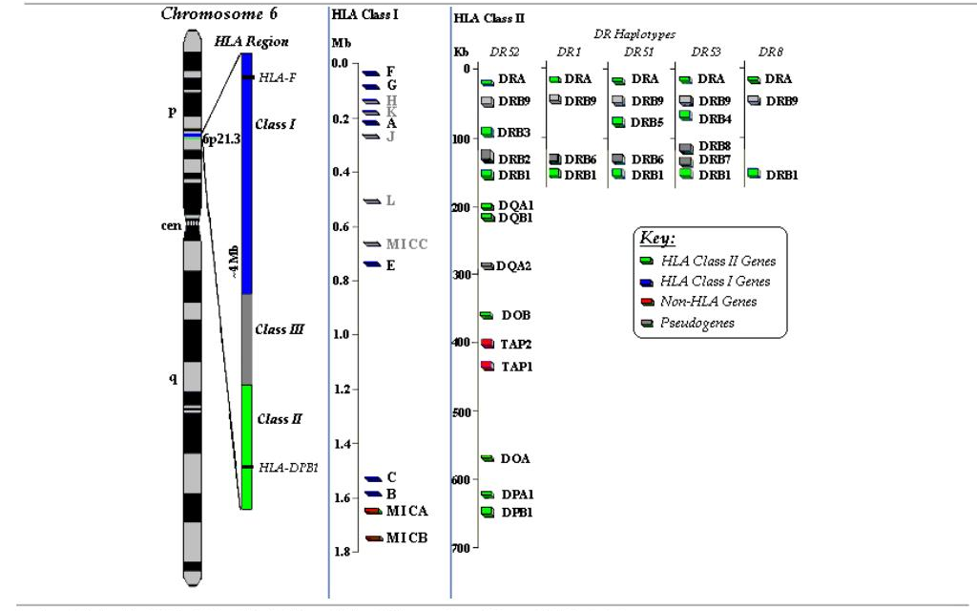

Slide 35
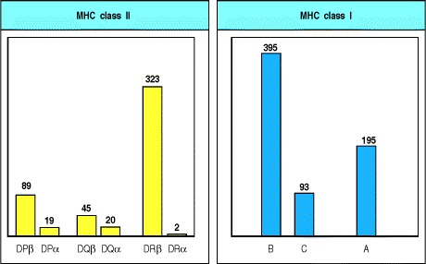
Polymorphism
The term polymorphism comes from the Greek poly, meaning many, and morphe, meaning shape or structure
within-species variation at a gene locus, and thus in its protein product; the variant genes that can occupy the locus are termed alleles
more than 200 alleles of some human MHC class I and class II genes
With the notable exception of the DRα locus, which is functionally monomorphic, each locus has many alleles.
The number of different alleles is shown in this figure by the height of the bars. The figures are the numbers of HLA alleles currently officially assigned by the WHO Nomenclature Committee for Factors of the HLA System as of August 2000.

Slide 36
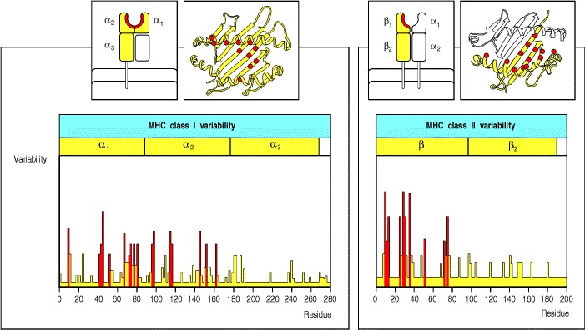
MHC polymorphism affects antigen recognition by T cells
The products of individual MHC alleles can differ from one another by up to 20 amino acids, making each variant protein quite distinct.
Most of the differences are localized to exposed surfaces of the outer domain of the molecule, and to the peptide-binding groove in particular
The polymorphic residues that line the peptide-binding groove determine the peptide-binding properties of the different MHC molecules.
Polymorphism in MHC class I molecules affects which amino acids line these pockets and thus their binding specificity.
Different allelic variants of MHC class II molecules also bind different peptides, but the more open structure of the MHC class II peptide-binding groove and the greater length of the peptides bound in it allow greater flexibility in peptide binding
Notes:
In consequence, the anchor residues of peptides that bind to each allelic variant are different. The set of anchor residues that allows binding to a given MHC class I molecule is called a sequence motif. These sequence motifs make it possible to identify peptides within a protein that can potentially bind the appropriate MHC molecule, which may be very important in designing peptide vaccines.
It is therefore more difficult to predict which peptides will bind to MHC class II molecules.

Slide 37
Mhc polymorphism & vaccine design
Few human will share the same set of alleles
different people will react to a pathogen infection in a non similar manner
A CTL based vaccine must include epitopes specific for eacg HLA allele in a population
It must consist of ~800 MHC class I epitopes and ~400 class II epitopes

Slide 38
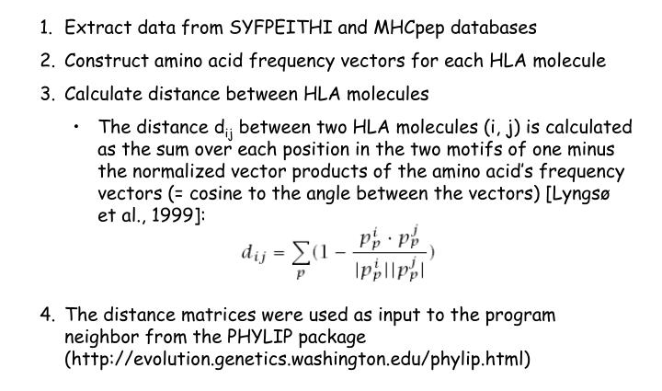
Clutering method

Slide 39
MHC supertypes
Many MHC molecules have similar specificities
MHC molecules with similar specificities can be grouped together
Methods to define Supertypes
Primary (Sequence)
Tertiary (Structure)
Shared peptide binding motifs
Identification of cross reacting peptides
Ability to generate methods that can predict cross binding peptides

Slide 40
HLA-I Supertypes
HLA-1 has been defined by structural similarities, shared peptide-binding motifs, and identification of cross-reacting peptides
Sette and Sidney: Based on motifs derived from binding data or sequencing of endogenously bound peptides, along with simple structural analyses: HLA-A1, -A2, -A3, -A24, -B7, -B27, -B44, -B58, -B62
Ole Lund’s group:using this similarity to cluster alleles into supertypes: constructed hidden Markov models (HMMs): Gibbs sampling procedure and defined a similarity measure between these sequence motifs: three new HLA-I supertypes HLA-A26, -B8, and -B39

Slide 41
HLA-II Supertypes
peptide binding data for HLA-II molecules is less available than those for HLA-I molecules due to the complexity of HLA-II structure
Ou et al.:grouped HLA-DR molecules into seven different functional supertypes on the basis of their ability to bind and present antigenic peptides to T cells and their association with susceptibility or resistance to disease
Castelli et al: defined an HLA-DP4 supertype and supported the existence of three main binding supertypes among HLA-DP molecules.
Doytchinova et al. : applied a combined bioinformatics approach using both protein sequence and structural data, to 2,225 HLA-II molecules, to detect similarities in their peptide-binding sites for definition of HLA-II supertypes: They defined 12 HLA-II supertypes, including five DRs (DR1, DR3, DR4, DR5, and DR9), three DQs (DQ1, DQ2, and DQ3), and four DPs (DPw1, DPw2, DPw4, and DPw6).

Slide 42
Greenbaum et al.:determined the binding capacity of a large panel of non-redundant peptides for a set of 27 common HLA DR, DQ, and DP molecules: measured binding data were then used to define class II supertypes on the basis of shared binding repertoires: Seven different supertypes (main DR, DR4, DRB3, main DQ, DQ7, main DP, and DP2) were defined
according to motif-based supertype classification: seven different supertypes were defined after the analysis of 27 HLA II proteins
All the molecules belonging to the DP genetic locus (DPB1*0101, DPB1*0201, DPB1*0401, DPB1*0402, DPB1*0501, and DPB1*1401) were grouped into a single supertype; DQ proteins were grouped into two different supertypes, each containing three HLAs: (DQB1*0301, DQB1*0302, DQB1*0401) and (DQB1*0201, DQB1*0501, DQB1*0602).
The motif-based classification of the DR proteins is less defined compared with the other loci. The HLA-DR can be grouped into four supertypes: (DRB1*0401, DRB1*0405, DRB1*0802, DRB1*1101), (DRB3*0101, DRB3*0202), (DRB1*0301, DRB1*1302), and the fourth containing the remaining DR proteins.
Functional and motif-based clustering of 27 defined HLA-II molecules revealed the presence of proteins sharing both functional and structural properties, thus supporting the concept of HLA-II supertypes.

Slide 43
Novel supertypes
Splitting the A1 supertype alleles into a new A26 supertype
Splitting the A1 supertype alleles into a new B27 supertype
B8 alleles may define their own supertype

Slide 44
Main features of MHC
Providing the strongest barrier to transplantation
Play a central role in generation and execution of immune response – Presentation of peptide antigens to T cells
Susceptibility to infectious diseases and development of autoimmune diseases

Slide 45
HLA and Clinical medicine
1. HLA and transplantation rejection
2. HLA related-Disease
3. HLA abnormal expression and disease
4. HLA and human ID for crime medical
detection and identification of progeny
5. Mating preference and olfactory sense ?
6. CNS development and repair ?

Slide 46
Questions
All are features of cell-surface HLA-B molecules, EXCEPT:
A. They are associated with β2 microglobulin.
B. They bind exogenous peptides.
C. They are polymorphic.
D. They are expressed on B lymphocytes.
E. They can be bound by CD8 molecules.

Slide 47
Which one of the following is TRUE about class II MHC molecules?
A. They consist of an alpha chain of three domains and a β2microglobulin.
B. They are found in all nucleated cells of our body.
C. They are involved in antigen presentation to CD8+ cytotoxic lymphocytes.
D. They consist of DR, DQ, and DP molecules.
E. They are located on the X chromosomes

Slide 48
References
Janeway CA Jr, Travers P, Walport M, et al. Immunobiology: The Immune System in Health and Disease. 5th edition. New York: Garland Science; 2001. The major histocompatibility complex and its functions. Available from: https://www.ncbi.nlm.nih.gov/books/NBK27156/

